Slide 2
MARKETING IN A CRISIS
The economy has changed.
It’s not the 2020 we want, but it’s the 2020 we got.
The future is uncertain.
What’s a marketer to do?

Slide 3
ONE TEAM’S TALE
“30,000 Foot” ideas
Tactics for right now
Use the Chat or Q&A for questions or to ask for more examples.

Slide 4
30,000 FOOT IDEAS
Get out of your own head
Go to the Niches
It’s time for digital, baby

Slide 5
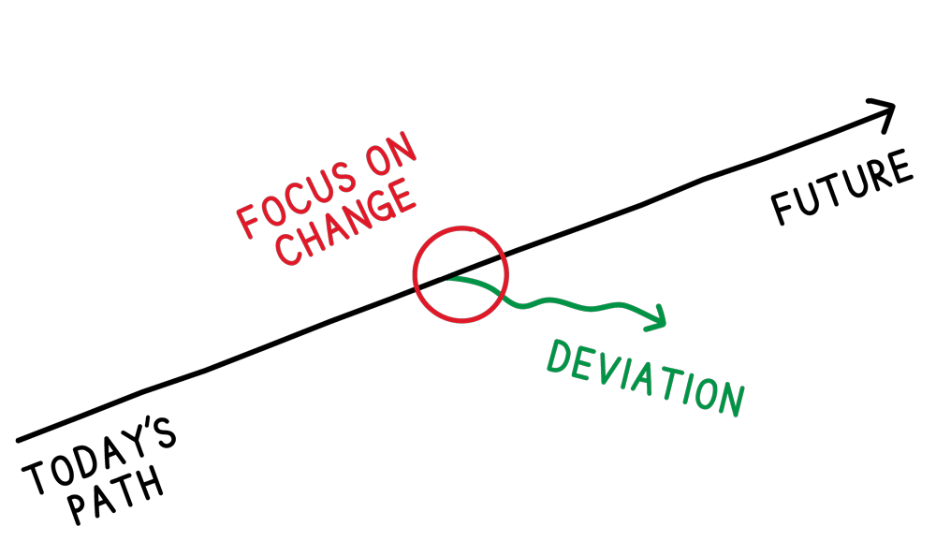
GET OUT OF YOUR OWN HEAD
The path has changed
Easy to focus internally
Focus on your customer’s changes/deviations

Slide 6
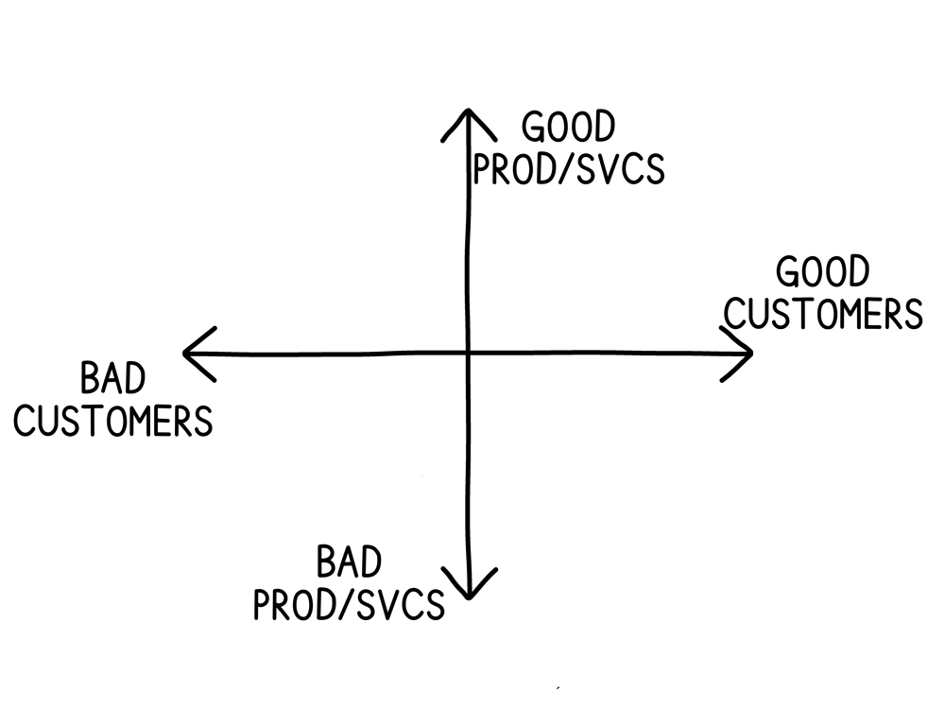
GO TO THE NICHES
Narrow your work
Start with Good/Bad
Leave things behind

Slide 7
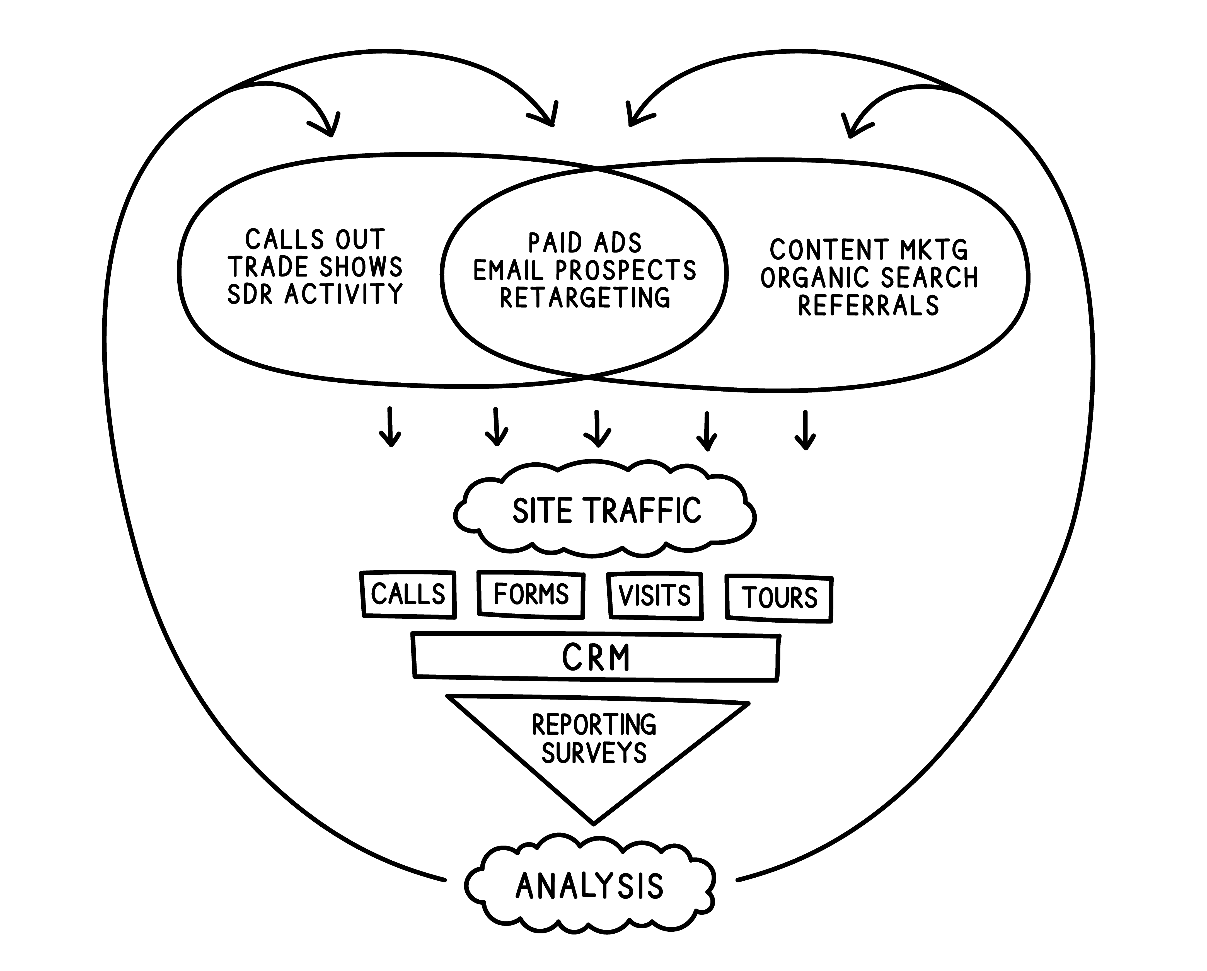
IT’S TIME FOR DIGITAL
How many webinar invitations this week?
Where is your good/good hanging out online?

Slide 8
TACTICS FOR RIGHT NOW
Who’s got (voice) mail
Start spreadin’ the news
Write and push
Bury the old stuff
Lighten the mood

Slide 9
YOU’VE GOT (voice) MAIL
Radio ad length – 120-150 words for your people
Company name
What instant value/advice do you have?
“We want to help. For instance, in times like these, have live person answering the phones.”

Slide 10
START SPREADIN’ THE NEWS
Press releases and press mentions
HARO, GetQwoted, PR Leads*
Guaranteed Press Releases*
FB Audience distribution
It’s all about the audience

Slide 11
WRITE AND PUSH
Content Marketing
Start with Questions from reps
Push content via email
Segments > broadcasts

Slide 12
BURY THE OLD STUFF
Already started on Content Marketing?
Review unvisited pages
Hide?
Re-fresh, re-write, re-submit SEO

Slide 13
LIGHTEN THE MOOD
Shared experiences like this are rare
Funny is hard, but self-deprecation makes it easier
We’re all human, act like it

Slide 14
QUESTIONS?
?
?
?

Slide 15
WHAT NOW?
Start with segments Good/Bad Custs/Prod/Svcs
Gather common questions
Get in touch

Slide 16
REVIEW
Who’s got (voice) mail
Start spreadin’ the news
Write and push
Bury the old stuff
Lighten the mood

Slide 17
THANK YOU! LET US KNOW IF WE CAN HELP.
info@leadgencompass.com
402-334-1824

