Slide 1
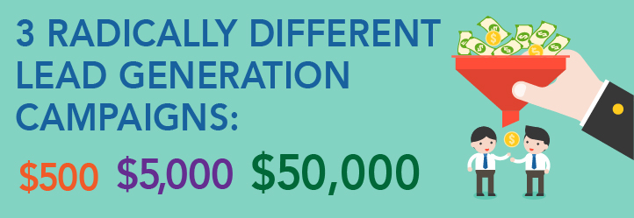




Slide 2


THE ORIGIN STORY
Two calls, back to back
Two radically different budgets
Same objective – MORE LEADS

Slide 3
THE ORIGIN STORY

Slide 4

PARAMETERS
Regional Injection Molder
2 Execs, 3 Acctg, 1 Mktg
3 Sales, 15 Floor/Whse
Need “filler” projects
Sales cycle, 90+ days

Slide 5
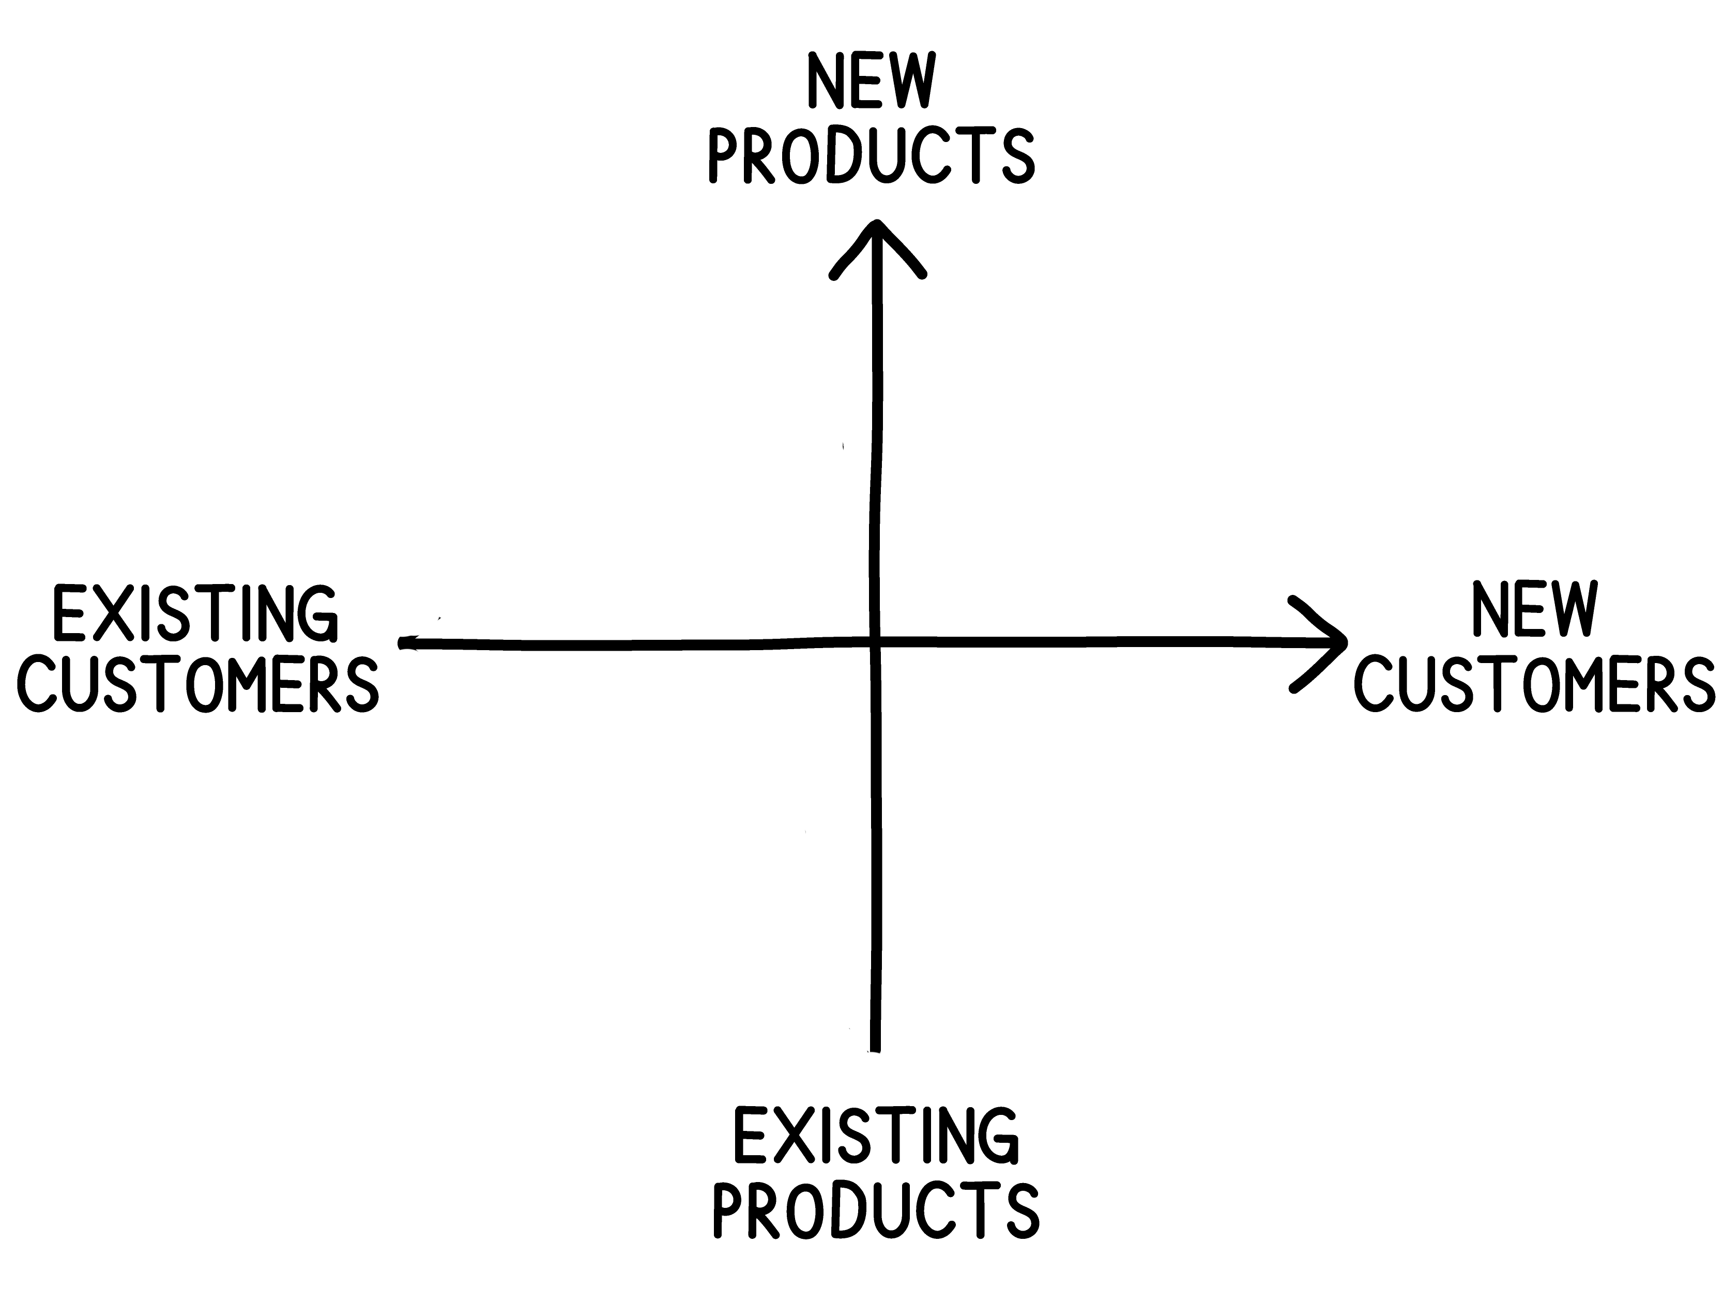
$500 LEAD GENERATION
Head to the Grid
Fast revenue
Existing, existing

Slide 6
$500 LEAD GENERATION
Profiling – # of prods/svcs by acct
ID look-a-likes in list
Phone/live survey
”Before” & “Found”
Leverage relationship

Slide 7
$5,000 LEAD GENERATION
Head to grid! Blitz!
Profile/Survey ($500)
Postcard refer ($300)
Adwords/Retarget/FB
($500/mo)
Testimonials on site

Slide 8
$5,000 LEAD GENERATION
Rhyming 3rd party list
“A&B” ($300)
Earn new biz offer
250 Postcards ($300)
Call day event ($300)

Slide 9
$5,000 LEAD GENERATION
250 PCard #2/3 ($600)
(no one has time)
$1000 for intern
$300 data party

Slide 10
$5,000 LEAD GENERATION
If hiring out (no internal work)
Profile, Survey, Adwords, Postcard, Calls
$2000 to 3rd party

Slide 11
$50,000 LEAD GENERATION
Not just more, different
Get target buyers in one place with customers – 1/5 ratio
ID concentrations

Slide 12
$50,000 LEAD GENERATION
Raise awareness ($5K)
Hire planner
- list quality
- topic
- venue

Slide 13
$50,000 LEAD GENERATION
Invitee thinks: “Who else is there?”
Limit to buyer profiles
Educate/Inspire
Focus on follow-up

Slide 14
$50,000 LEAD GENERATION
Structure project with success fee (50%)
20-50 match (1/5 ratio)
Speaker, venue, swag

Slide 15
$500, $5,000, or $50,000
Trick with all of them is measuring and re-investing in the next campaign
$1 to $1

Slide 16



QUESTIONS?

Slide 17
WHAT NOW?
Start with the Grid
Profiling A, B, C
Look-a-likes
Plan “what next”
Track it

Slide 18
REVIEW
$500 we’d
“look inside”
$5000 we’d go “inside out”
$50,000 we’d get “belly-to-belly”

Slide 19
THANK YOU!
info@leadgencompass.com
402-334-1824

